Slide 1
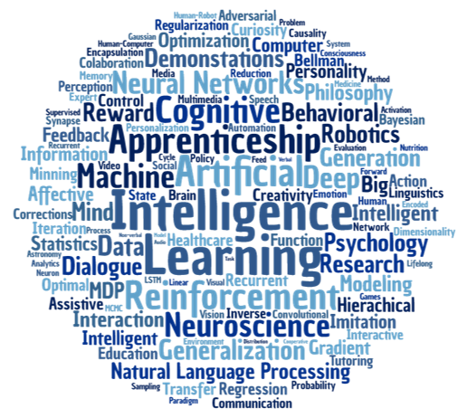
Making Sense of Web Data with Natural Language Processing
Cork Big Data & Analytics, 2017-11-13
Image: https://markovikj.com/assets/img/wclouds/research.png

Slide 2

About Me
Johannes Ahlmann
fluquid.com
Sales & Client Intelligence
Intelligent Lead Generation
Large-scale web crawls
Gathering and Enriching Web Data
webdata.org
Share Libraries and Best Practices
Bring Data Scientists and SME Companies together
ForDevelopers
AwesomeAvailableDatasets
Contact: johannes@fluquid.com
fluquid

Slide 3
Data is Noisy
Data is noisy (typos, free text, etc.) ("Mnuich", " Munich", "munich")
Data can vary syntactically ("12.00", 12.00, 12)
Many ways to represent the same entity ("Munich", "München", "Muenchen", "Munique", "48.1351° N, 11.5820° E", "zip 80331–81929", "[ˈmʏnçn̩]", "Minga", "慕尼黑")
Entity representations are ambiguous <Munich City, Germany> <Munich County, Germany> <Munich, North Dakota>
Wikipedia disambiguation

Slide 4
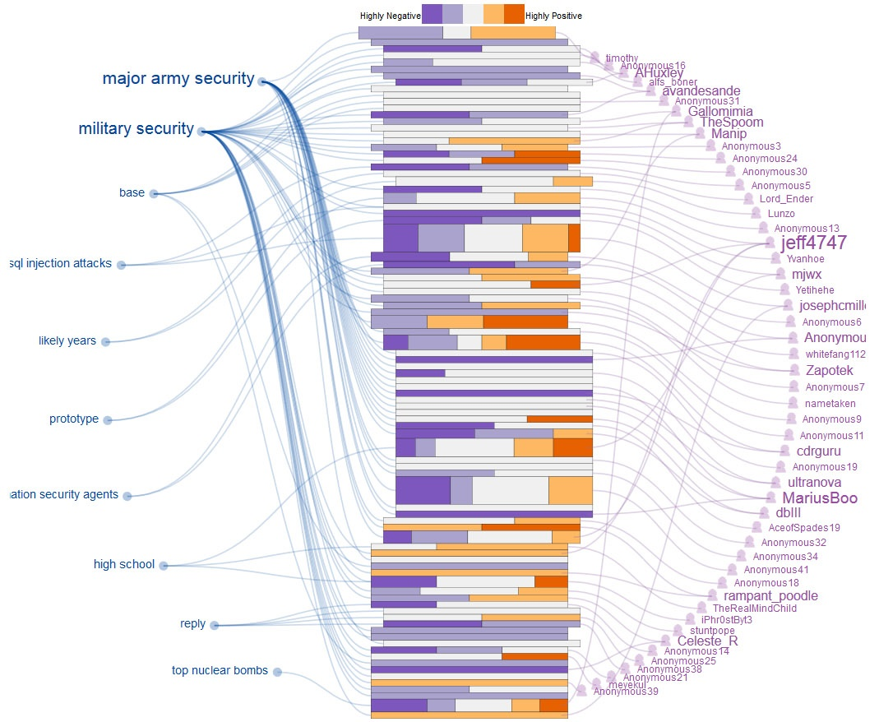
Natural Language Processing
Content Extraction
Parsing
Named Entity Extraction,
Topic Modelling
Sentiment Analysis
Image: http://www.cs.ubc.ca/cs-research/lci/research-groups/natural-language-processing/image/convis/3.jpg

Slide 5

1) Content Extraction
Challenge: Given a document, extract the main text information as plaintext
Libraries
html-text
boilerpipe (java)
dragnet
apache tika (java; supports many formats)
Example - Readability
Image: http://webdata-scraping.com/media/2016/04/web_scraping_spider.png

Slide 6
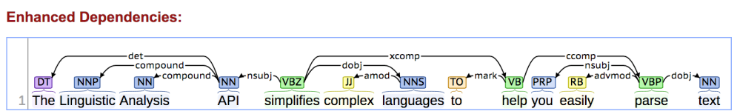
2) Parsing
Spacy 2 is awesome!
Sentence segmentation
Word segmentation
Lemmatization/stemming
Parsing
POS (part of speech)
Word vectors
Word/sentence similarity
etc.
Textacy
Extends spacy functionality
syntaxnet
Parser and language understanding engine developed by Google
For more advanced use cases
Image:https://stanfordnlp.github.io/CoreNLP/images/Cate-Blanchett.png

Slide 7
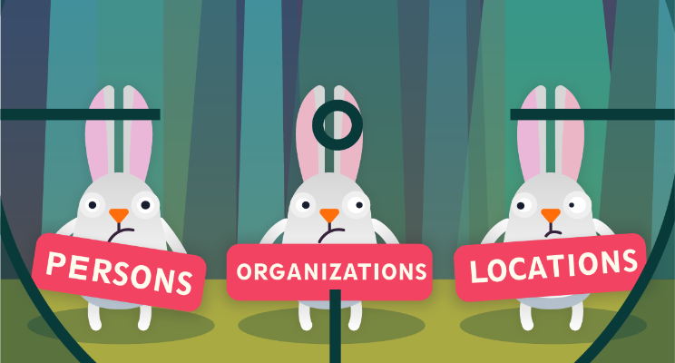
3) Named Entity Extraction
Entities: persons, organizations, locations, date, time, money, email, social media, postal address, etc.
NER, Disambiguation
spacy - basic entity extraction
stanbol - pretty good for "production use"
dbpedia spotlight - between stanbol and AIDA
AIDA - very good, but slow
Normalization
cleanco - companies
probablepeople - person names
python-phonenumbers - international phone numbers
libpostal - postal addresses
webstruct - train your own NER with annotated training data
Image: https://pbs.twimg.com/media/Ct_oP9AXYAExsNq.jpg

Slide 8
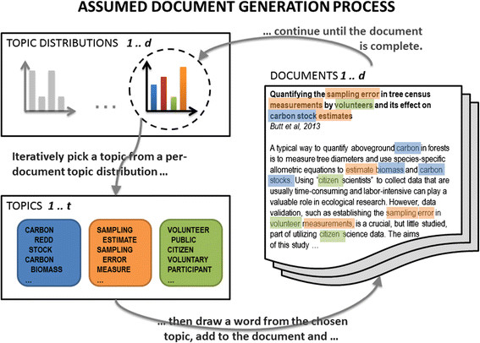
4) Topic Modelling
Goal: Dimensionality Reduction from 50k+-dimensional token space to "topic" manifold
Assumption: Every document covers several different "topics"
A topic is comprised of words that often co-occur
Approach: Analyze which words co-occur more frequently with each other than with other words
Can be used as a basis for clustering, similarity, etc.
Libraries
gensim LDA
sklearn NMF
Demo
Image: http://bit.ly/2A0hbcA

Slide 9

5) Sentiment Analysis
Identify what sentiment an expression carries
Polarity, Subjectivity
Paragraph, Sentence, Entity
Challenges:
Generally messy and often does not produce great results
Sarcasm, Irony, Context
Mixed sentiments in any single statement
Libraries
vaderSentiment
twitter-sent-dnn
Examples
cryptocurrencies
twitter "performance review" tweets
Image: https://thumbs.dreamstime.com/t/reaction-smileys-vector-clip-art-30534441.jpg

Slide 10

Metadata
Use pre-structured information from web data where available
Formats
Metadata (schema.org)
Microdata (vcard)
json-ld
OpenGraph
Twitter Card
Libraries
Extruct
Apache Any23 (java)
Image: https://i2.wp.com/blog.parse.ly/wp-content/uploads/2015/08/Metadata-Tags-Use.jpg

Slide 11

Miscellaneous
Language Detection
cld2-cffi
Find many possible terms in text
pyahocorasick
Structured Data Extraction
Pydepta
Demo
Unicode Normalization
unidecode
Image: http://windows.ischool.syr.edu/wp-content/uploads/2009/06/visit-with-clare-gail-008.jpg

Slide 12
Questions?
Content Extraction in R
boilerpipeR
Wordpress Plugin Scanner
sorry, it's not open-source yet; but I will open-source it soon at github.com/fluquid
Extract Bibliography from Academic Papers
grobid (GeneRation Of BIbliographic Data)
pdfextract
CERMINE
Find similar skills, capabilities
gensim word2vec
spacy even comes with semantic sentence similarity ;)

